Slide 1
CSET301 – AI-ML
Lecture 20 : K – Nearest Neighbour (KNN)

Slide 2
K – Nearest Neighbour (KNN)
“Birds of a feather flock together“
• In other words, things that are alike are likely to have properties that are alike.
• We can use this principle to classify data by placing it in the category with the most similar, or "nearest" neighbors.

Slide 3
K – Nearest Neighbour (KNN)
Nearest neighbor classifiers are defined by their characteristic of classifying unlabeled examples by assigning them the class of the most similar labeled examples.
Despite the simplicity of this idea, nearest neighbor methods are extremely powerful. They have been used successfully for:
– Computer vision applications, including optical character recognition and facial recognition in both still images and video
– Predicting whether a person enjoys a movie which is recommended by Netflix
– Identifying patterns in genetic data, for use in detecting specific protein or diseases

Slide 4
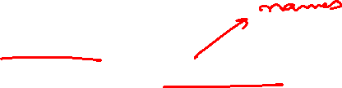
KNN Algorithm
The kNN algorithm begins with a training dataset made up of examples that are classified into several categories, as labeled by a nominal variable.
• Assume that we have a test dataset containing unlabeled examples that otherwise have the same features as the training data.
• For each record in the test dataset, kNN identifies k records in the training data that are the "nearest" in similarity, where k is an integer specified in advance.
• The unlabeled test instance is assigned the class of the majority of the k nearest neighbors

Slide 5
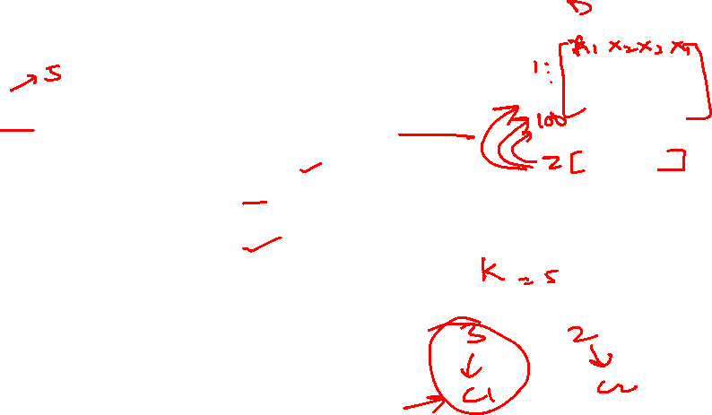
KNN Algorithm
Given k = number of nearest neighbours, D=training dataset.
for each test sample z=(x’, y’) do
compute distance between z and every sample point in D
select k nearest neighbours of z
return majority class label.
end for

Slide 6
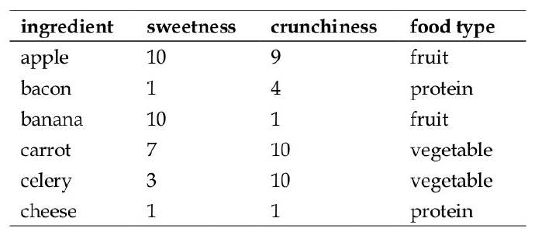
Example
Reference: Machine Learning with R, Brett Lantz, Packt Publishing

Slide 7
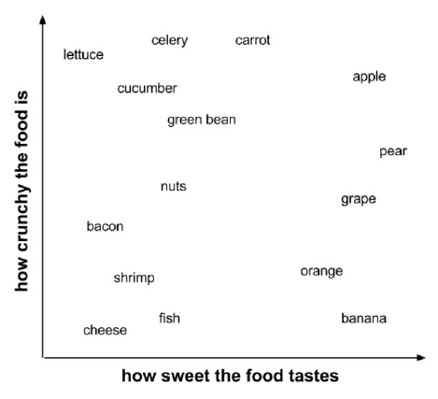
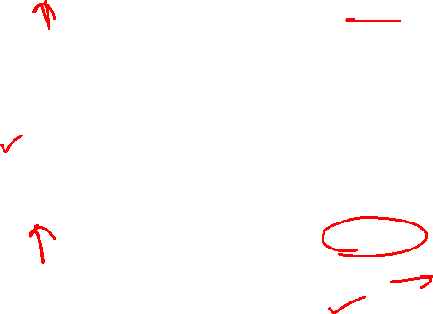
Example

Slide 8
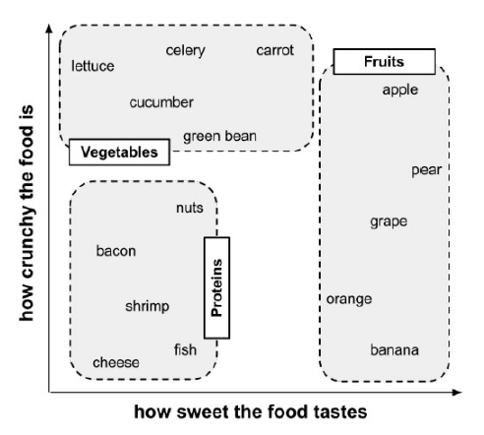
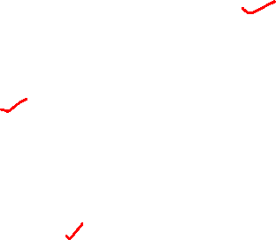
Example

Slide 9
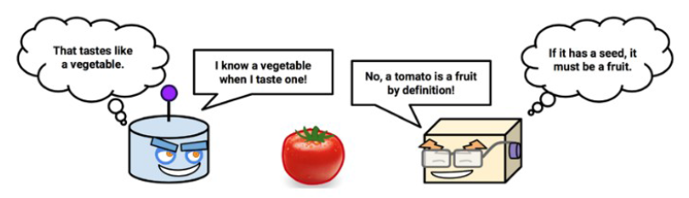

Classify me now!

Slide 10
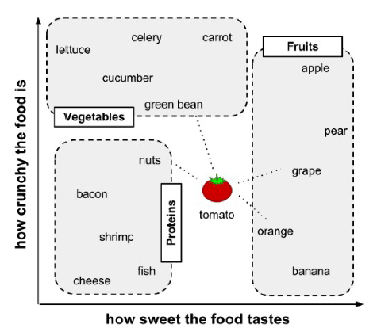
Example

Slide 11

Calculating Distance
Locating the tomato's nearest neighbors requires a distance function, or a formula that measures the similarity between two instances.
• There are many different ways to calculate distance.
• Traditionally, the kNN algorithm uses Euclidean distance, which is the distance one would measure if you could use a ruler to connect two points,
illustrated in the previous figure by the dotted lines connecting the tomato to its neighbors

Slide 12
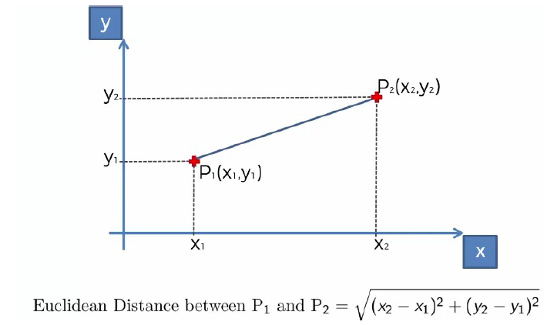
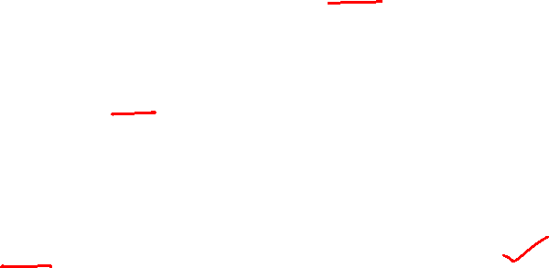
Calculating Distance

Slide 13


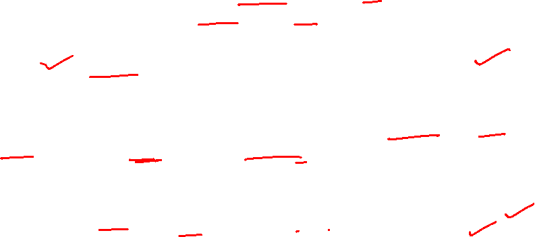
Distance
Euclidean distance is specified by the following formula, where p and q are the examples to be compared, each having n features. The term p1 refers to the value of the first feature of example p, while q1 refers to the value of the first feature of example q:
The distance formula involves comparing the values of each feature. For example, to calculate the distance between the tomato (sweetness = 6, crunchiness = 4), and the green bean (sweetness = 3, crunchiness = 7), we can use the formula as follows:

Slide 14
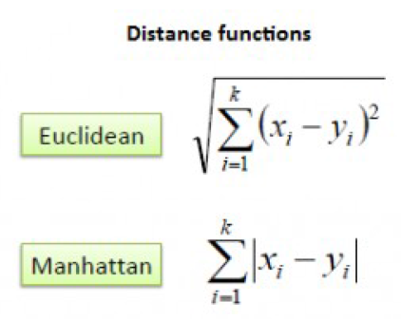
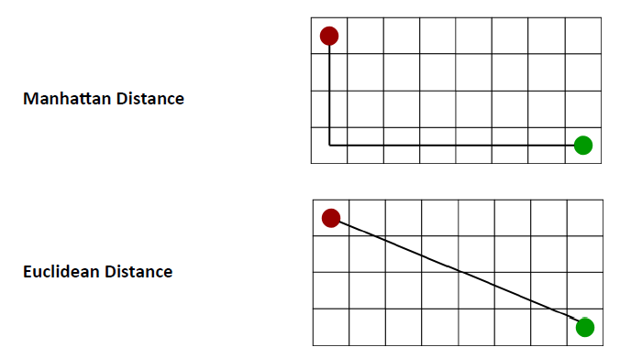
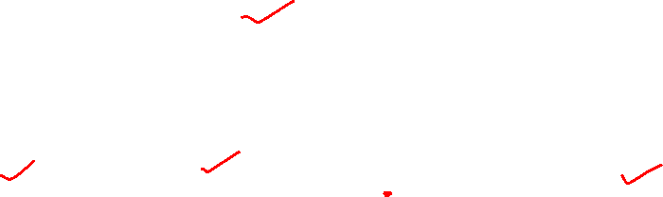
Distance

Slide 15
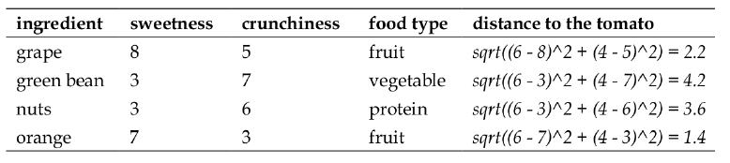
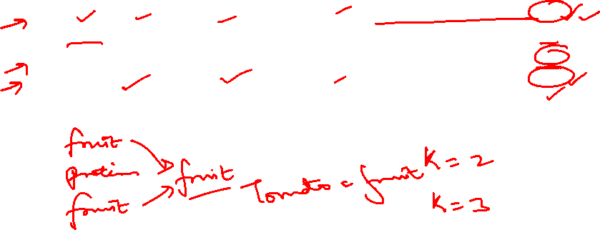
Closest Neighbours

Slide 16
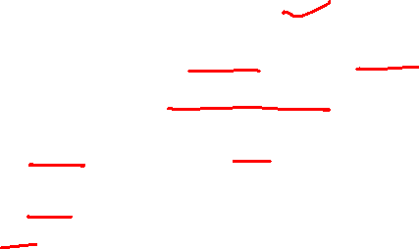
Choosing appropriate K
Deciding how many neighbors to use for kNN determines how well the model will generalize to future data.
• The balance between overfitting and underfitting the training data is a problem known as the bias-variance tradeoff.
If k is too small, sensitive to noise.
If k is too large, the neighbourhood may include points from other classes.

Slide 17
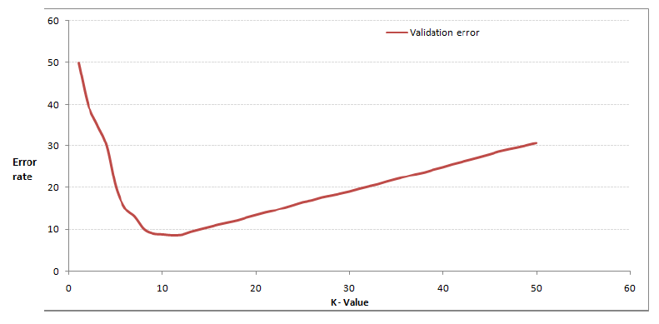
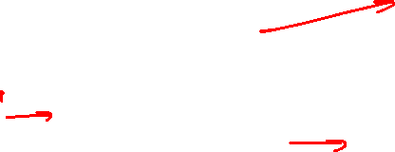
Choosing appropriate K

Slide 18
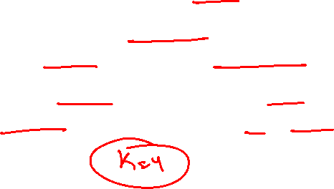
Choosing appropriate K
In practice, choosing k depends on the difficulty of the concept to be learned and the number of records in the training data.
• Typically, k is set somewhere between 3 and 10. One common practice is to set k equal to the square root of the number of training examples.
• In the classifier, we might set k = 4, because there were 15 example ingredients in the training data and the square root of 15 is 3.87.

Slide 19

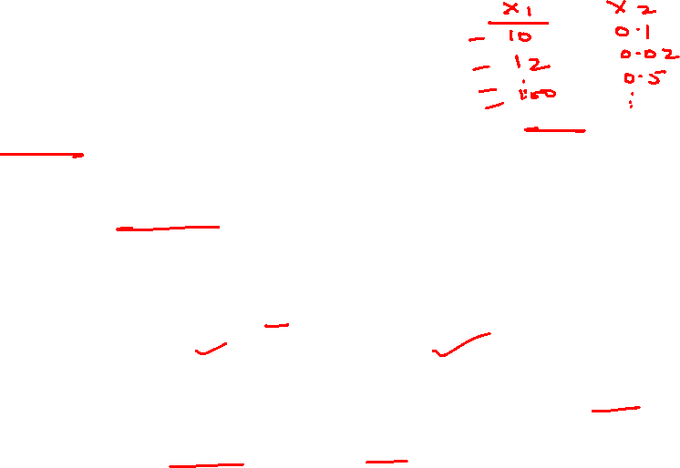
Min – Max Normalization
The traditional method of rescaling features for kNN is min-max
normalization.
• This process transforms a feature such that all of its values fall in a range between 0 and 1. The formula for normalizing a feature is as follows. Essentially, the formula subtracts the minimum of feature X from each value and divides by the range of X:
• Normalized feature values can be interpreted as indicating how far, from 0 percent to 100 percent, the original value fell along the range between the original minimum and maximum.

Slide 20
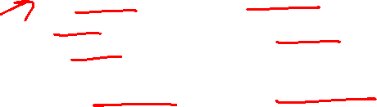
KNN Algorithm
Lazy Learner/Instance-based classifier: simply stores the training dataset (or does only minor pre-processing) and waits until it is given a test tuple
Less time in training, more time in testing.

Slide 21
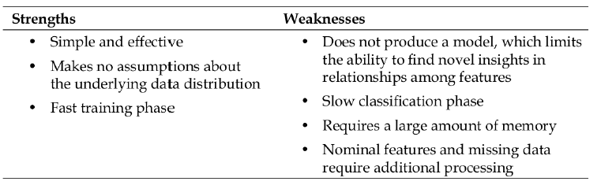
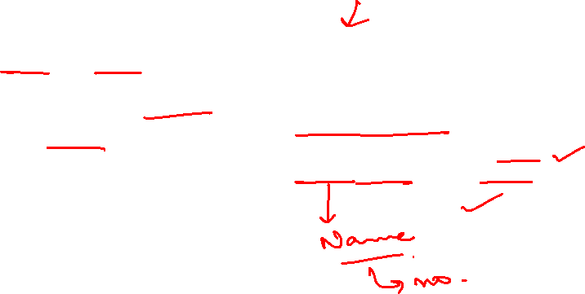
KNN Algorithm

Slide 22
Thank You

